Slide 1

Dart Basic Syntax

Slide 2
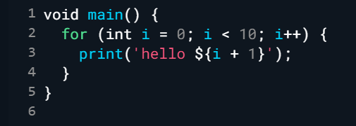
main function
It is the most important and mandatory part of any Dart Program. Any Dart script requires the main() method for its execution. This method acts as the entry point for any Dart application. It is responsible for executing all library functions, user-defined statements, and user-defined functions.

Slide 3
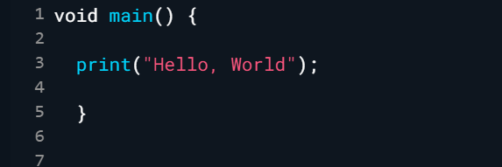
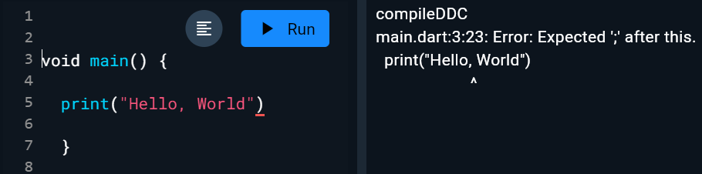
Semicolon in Dart
The semicolon is used to terminate the statement that means, it indicates the statement is ended here. It is mandatory that each statement should be terminated with a semicolon(;). We can write multiple statements in a single line by using a semicolon as a delimiter. The compiler will generate an error if it is not use properly.

Slide 4
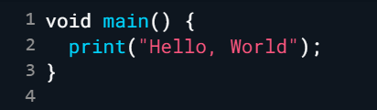

Dart Whitespace and Line Breaks

Slide 5
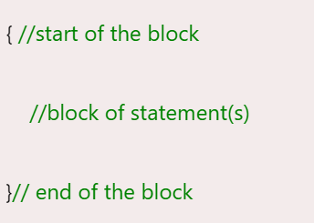
Block in Dart
The block is the collection of the statement enclosed in the curly braces. In Dart, we use curly braces to group all of the statements in the block.
Syntax:

Slide 6
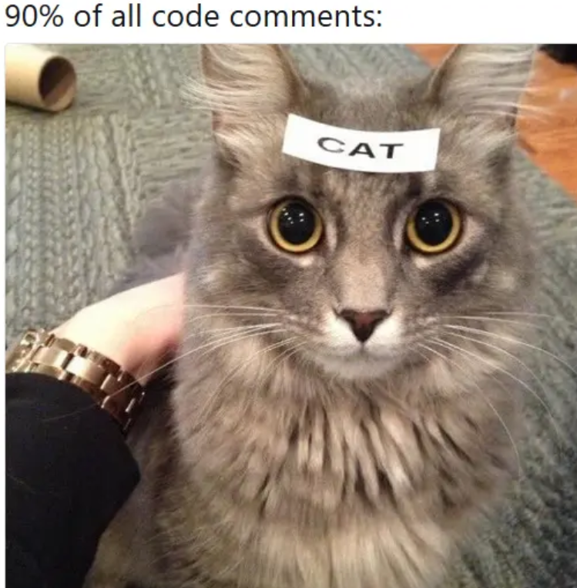
Dart Comments
Comments are the set of statements that are ignored by the Dart compiler during the program execution. It is used to enhance the readability of the source code. Generally, comments give a brief idea of code that what is happening in the code. We can describe the working of variables, functions, classes, or any statement that exists in the code. There are three types of comments in the Dart.

Slide 7
Types of Comments
Dart provides three kinds of comments :
Single-line comment
Multi-line comments
Documentation comment

Slide 8
